Slide 1
III CORPS
CJTF-82
LAND COMPONENT COMMAND
III CORPS
CONOPS, PHASE 1
DISCLAIMER:
This is for multiplayer online gaming using the Digital Combat Systems simulation software published by Eagle Dynamics. The information is not in any way suitable for real world use or operations.
Version: 1.0
Published: 2020-09-07

Slide 2
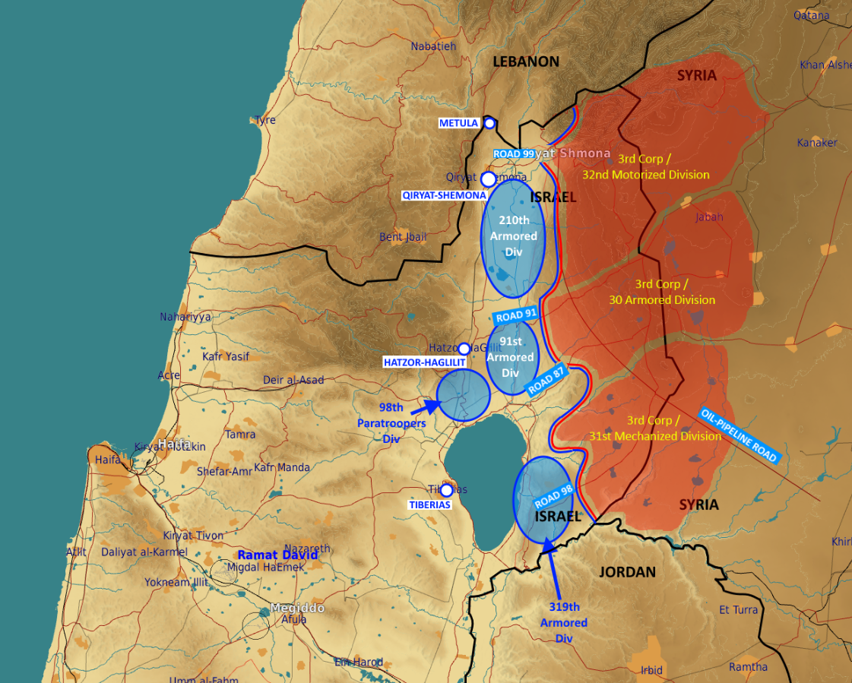
ENEMY SITUATION (D+0)
III CORPS

Slide 3
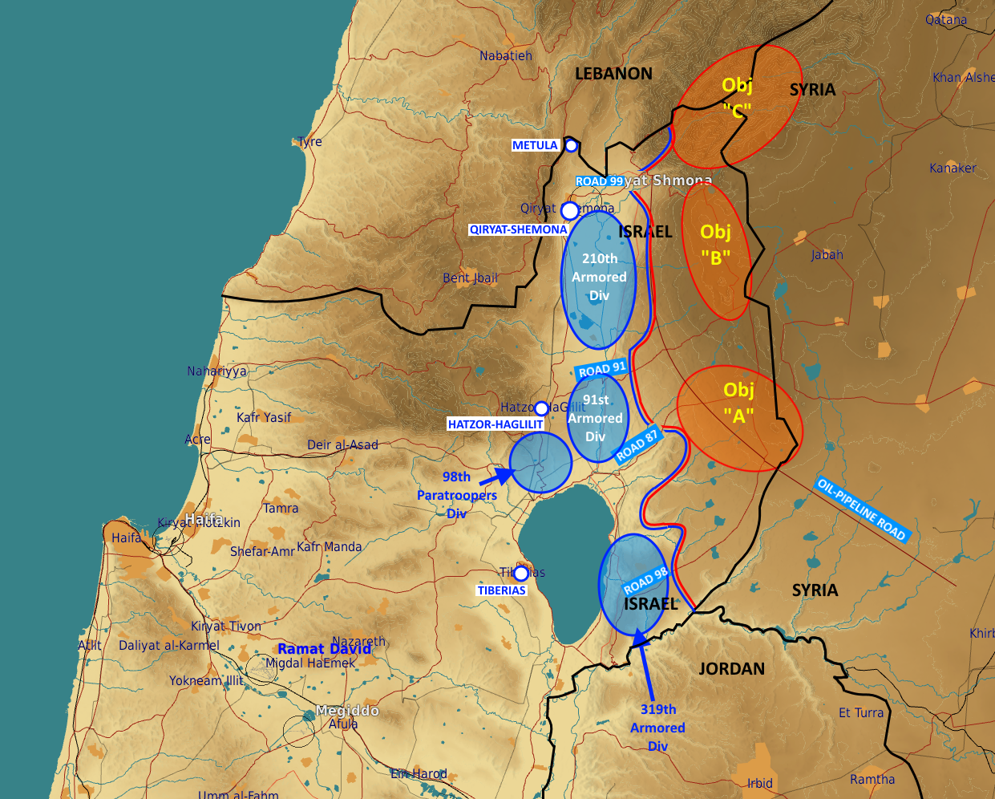
Concept of Operations (CONOPS)
IV CORPS
The basic fighting formation in the Syrian army is the division. Here is a representation of a division during an offansive.
The three manuevering brigades (Composed of armor and mechanized forces) are arranged in a «2-front, 1-rear» formation. This arrangement allows for an offensive over a wide front with a lot of firepower, while still having the 3rd brigade close behind. The rear-brigade is ready to support any of the front two brigades in case of high enemy resistance, or to exploit a success breakthrough, and pushing a fresh force forward into the enemy teritorry. The movement of the rear brigade forward may be done between the two front brigades, or directly «through» one of them – depending on terrain, roads and tactical situation.
One of the frontal brigades will be designated as the Main Effort (ME). This brigade will have priority in receiving support from the division-level assets. As shown here, Front Brigade #1 is the ME and is supported by the division’s Rocket-ARTY BN.
Further to the back are the divisional HQ, the logistics BN and an SA-15 BN protecting them.
A second BN of SA-8 will be close to the divisional Rocket-ARTY BN, defending it.

Slide 4
STAGES
III CORPS
This phase will be conducted in 5 stages:
Stage 1: ( D+0)
Assemble forces in assembly areas
Stage 2: ( D+1 to D+3 )
Shaping: Artillery and attack from JFACC on Objectives ”B” and “A”
Stage 3: (D+4 to D+5)
Deception effort: 319th Armored to approach Obj-”A” from the South with intent to have enemy 31st Mechanized redeploy facing South to counter 319th alleged offensive.
Main effort: starting D+8 by 91st Armored advance towards Obj-”B” from the South and 210th Armored advance towards Obj-”B” from the North.
Intent is to isolate enemy 31st Mechanized from the North, as well as to establish staging areas for stage-5 in offensive towards the Northern part of the GOLAN
Once main-effort begins, air attacks by JFACC to prioritize suppression of enemy combat strength as well as target enemy C2 of enemy’s 30th Armored (both of division level as well as of sub-units) to degrade enemy’s ability to counter the main effort.
Stage 4: (D+6 to D+7)
With support of 91st Armored harassing from the North, 319th Armored will attack remaining elements of enemy’s 31st Mechanized from the South to secure Obj-”A”
Air attacks from JFACC to support 319th maneuver by targeting enemy units to the South-East of Obj-”A”
Stage 5: (D+8 to D+10)
210th Armored will attack to the North towards the Southern slopes of Mt.HERMON
98th Paratroopers to dispatch an element (1-2 BNs strength) to conduct an airborne assault to seize Obj-”C” (Mt.HERMON)
If conditions allow, 210th will take advantage of the momentum to extend its offensive to seize enemy positions threatening the North area of the GOLAN
Air attacks from JFACC to support by engaging enemy forces to the North and East of Obj-”C”

